Slide 1

Bacterial Fine-Tuning of InstaNovo for Large-Scale Wastewater Proteomics
Wenjing Yang
04/01/2026
Quick overview - InstaNovo

Slide 2
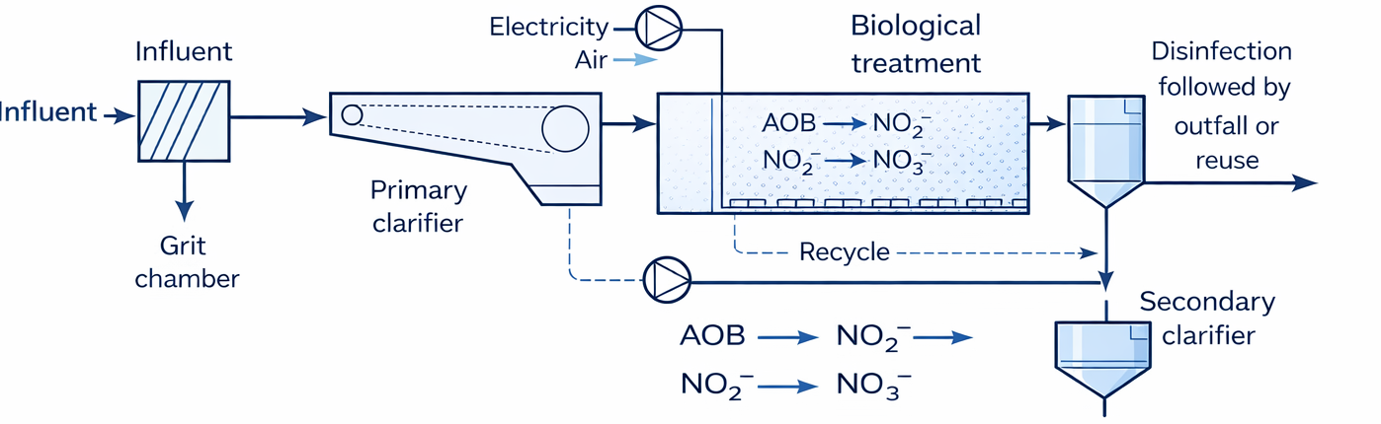
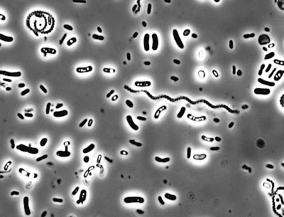
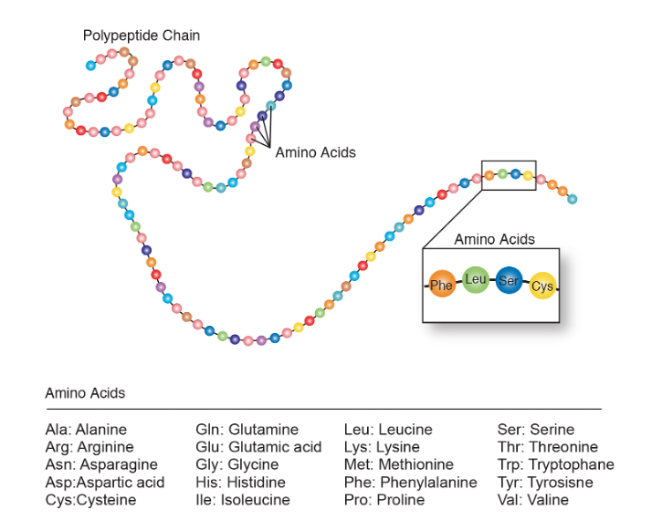
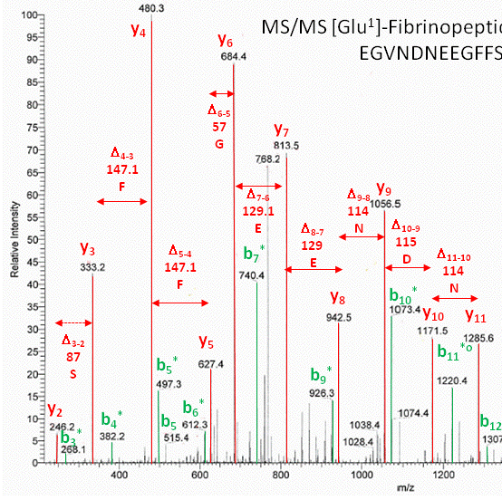
1 Background and motivation
Influent flow
Wastewater treatment
Outputs
Understanding the bacterial functions and mechanisms is essential for wastewater plants. Bacterial Proteomics
Peptide sequencing
( a set of amino acids)
Spectra
AI model
+ domain-specific data
+ Bacteria proteomics
→ Fine-Tuning
Figure: NB02a Mass Spectrometry Based Proteomics, Approach - Proteome Exploration Laboratory, B2. Sequence Determination Using Mass Spectrometry - Chemistry LibreTexts

Slide 3
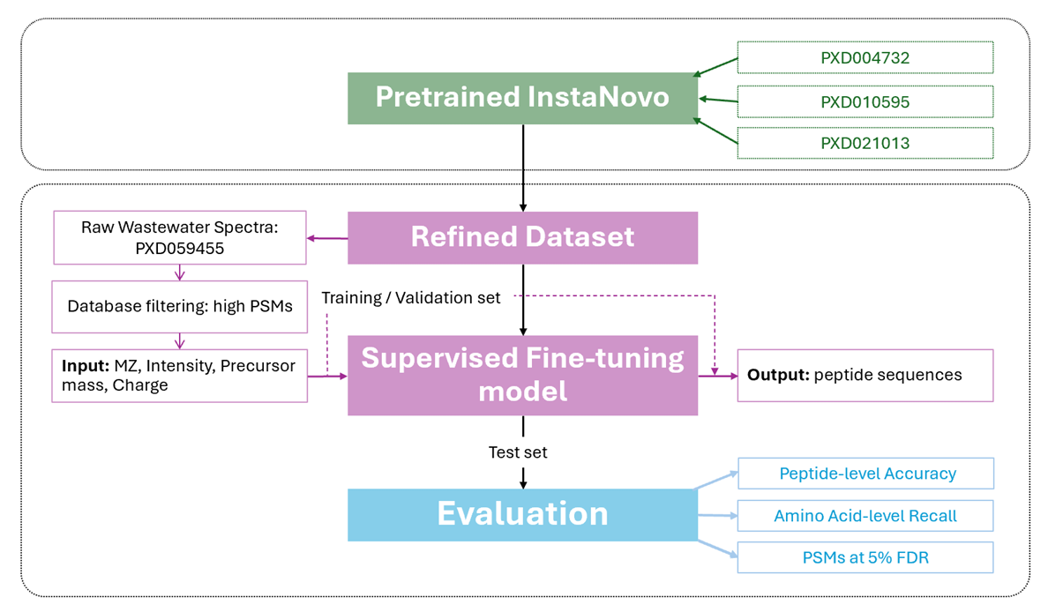

2 Project mind map
* PSMs = peptide-spectrum matches

Slide 4
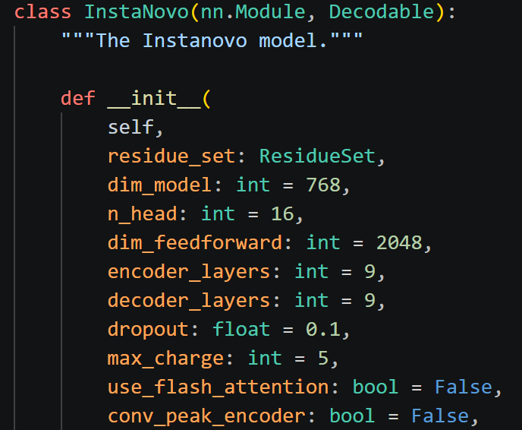
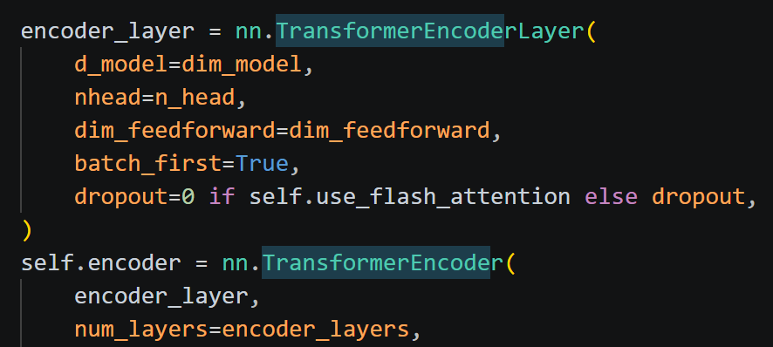
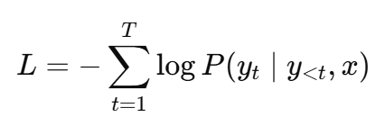
Step 1- pre-trained model: Instanovo
Model type: Deep learning
Learning type: Supervised
Task: peptide sequencing
Training objective: Token-level classification
Architecture: Transformer encoder - decoder
Model architecture:
reads spectra
generates peptide tokens
Hidden dimension: 768
Encoder layers: 9
Decoder layers: 9
Attention heads: 16
Feed-forward: 2048
Activation function: ReLU
Loss function: CrossEntropyLoss
Parameters: 94,619,169
the size of the vector representation used
learn multiple peak-token relationships in parallel
the size of the internal MLP inside each Transformer layer
de novo Sequencing Introduction | Bioinformatics Solutions Inc.

Slide 5
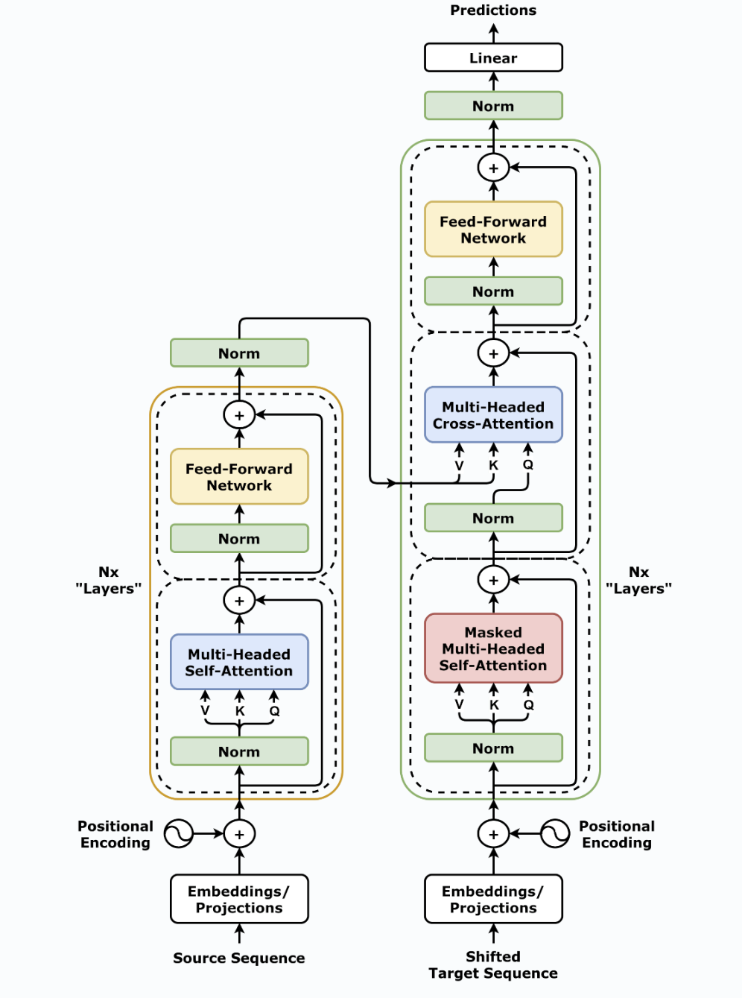
Transformer encoder - decoder
For example: translation
Input: “Cats like eating fish.”
Projection: vector + position
Self-attention: find relationship
Feed-Forward: process relationship
Output: “猫喜欢吃鱼。”

Slide 6
Step 2- Prepare dataset workflow
1. Raw MS data
( .raw files)
Select and download the right database (in UniProt)
2. MaxQuant database search
3. Filter reliable data
High-confidence PSM Filtering
(PEP ≤ 0.02, Score ≥ 60, remove noise)
Spectrum extraction
(.raw-derived .mgf → filtered .mgf)
4. Build InstaNovo training table
(link Peptide sequence + scan number
+ spectrum information)
5. Split and transfer format for the database
(train 70% / validation 15% / test 15%)
Data source: ProteomeXchange Dataset PXD010595

Slide 7
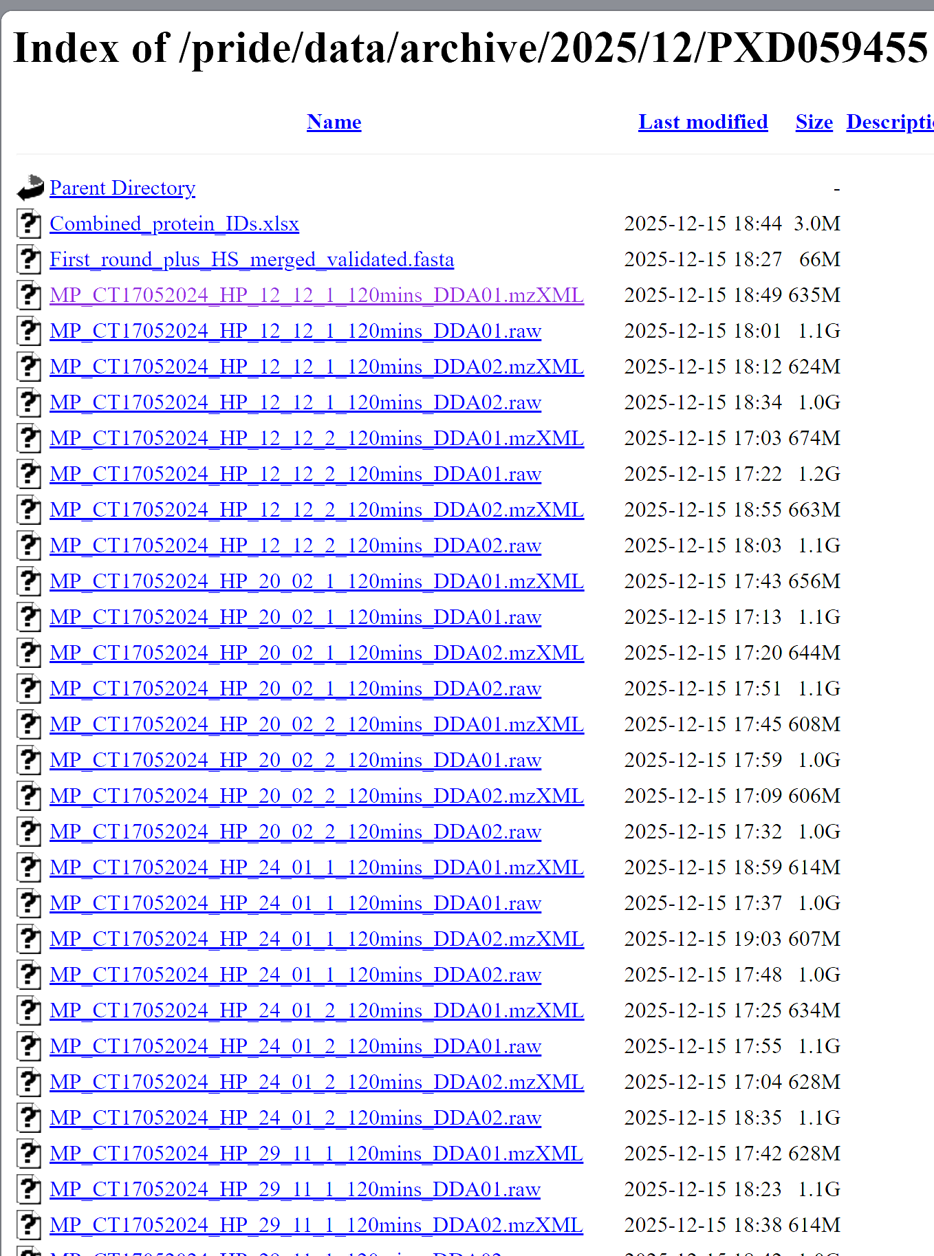
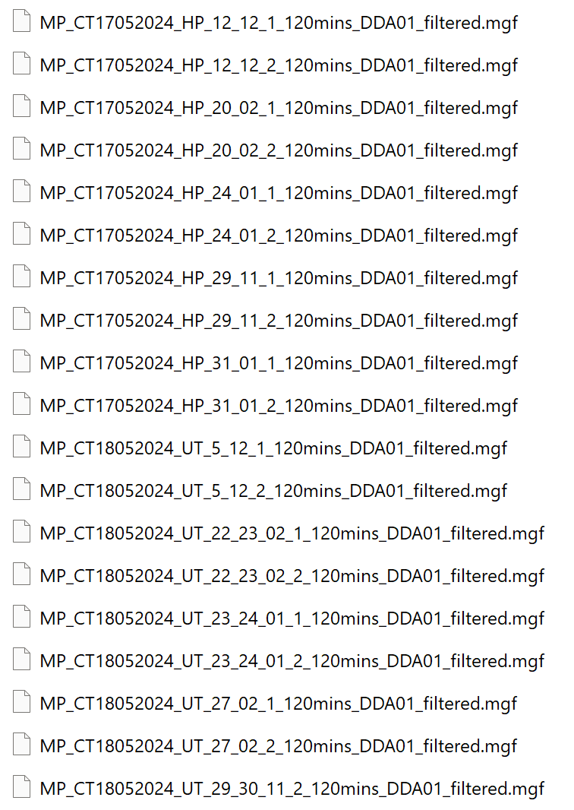
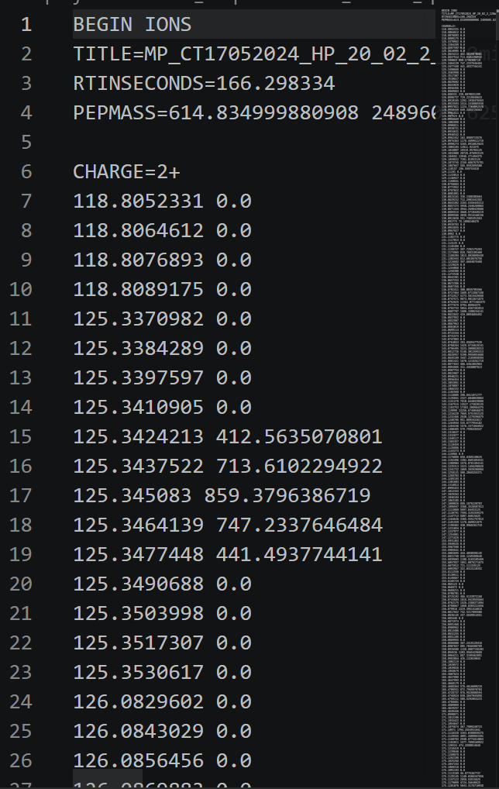
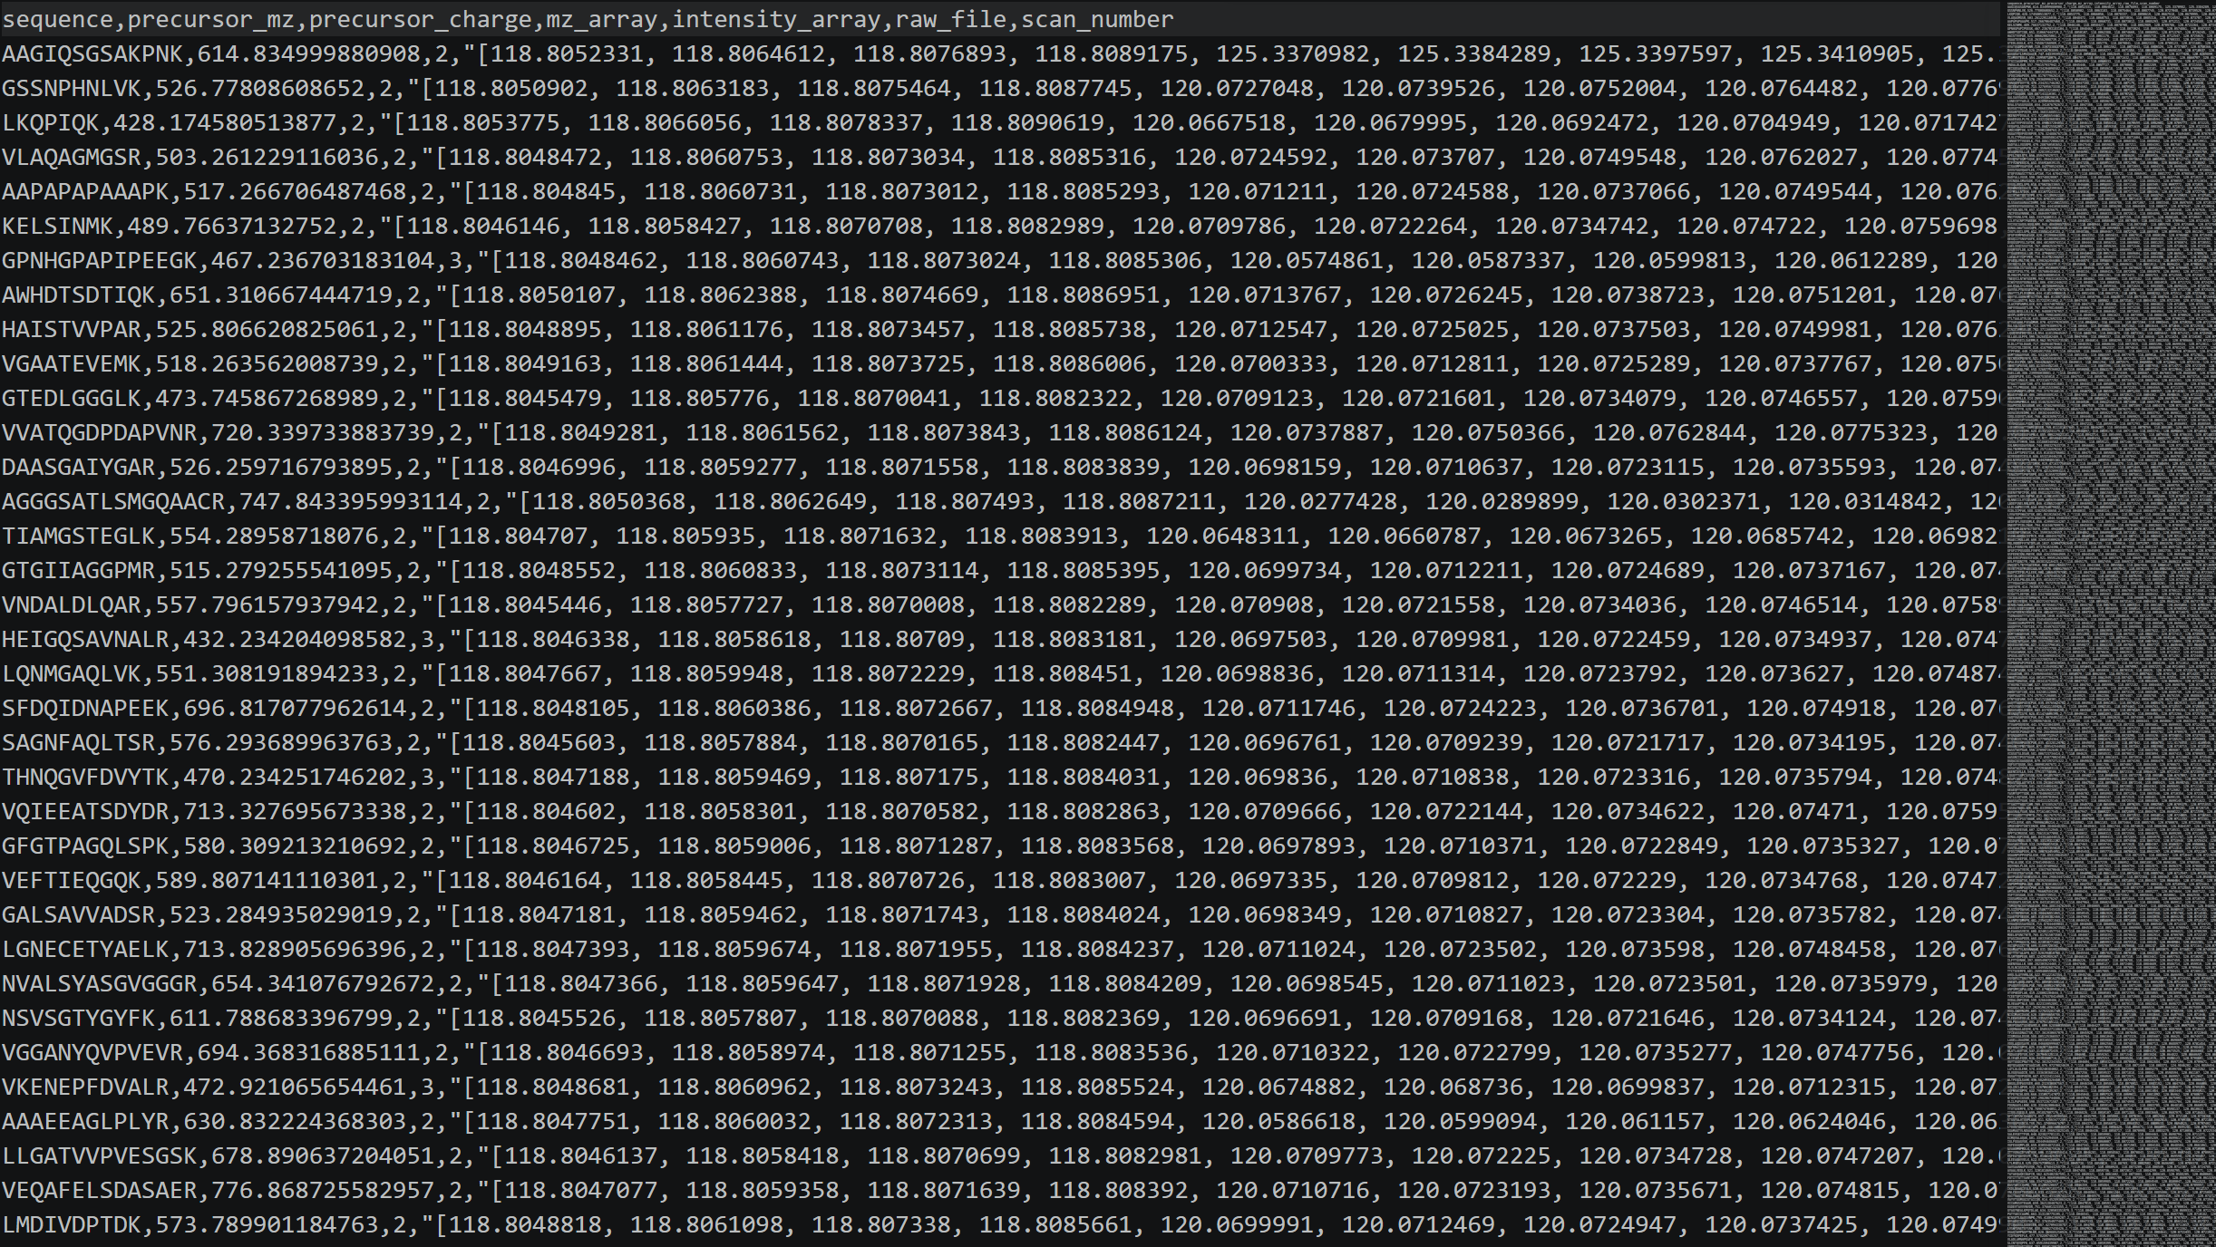
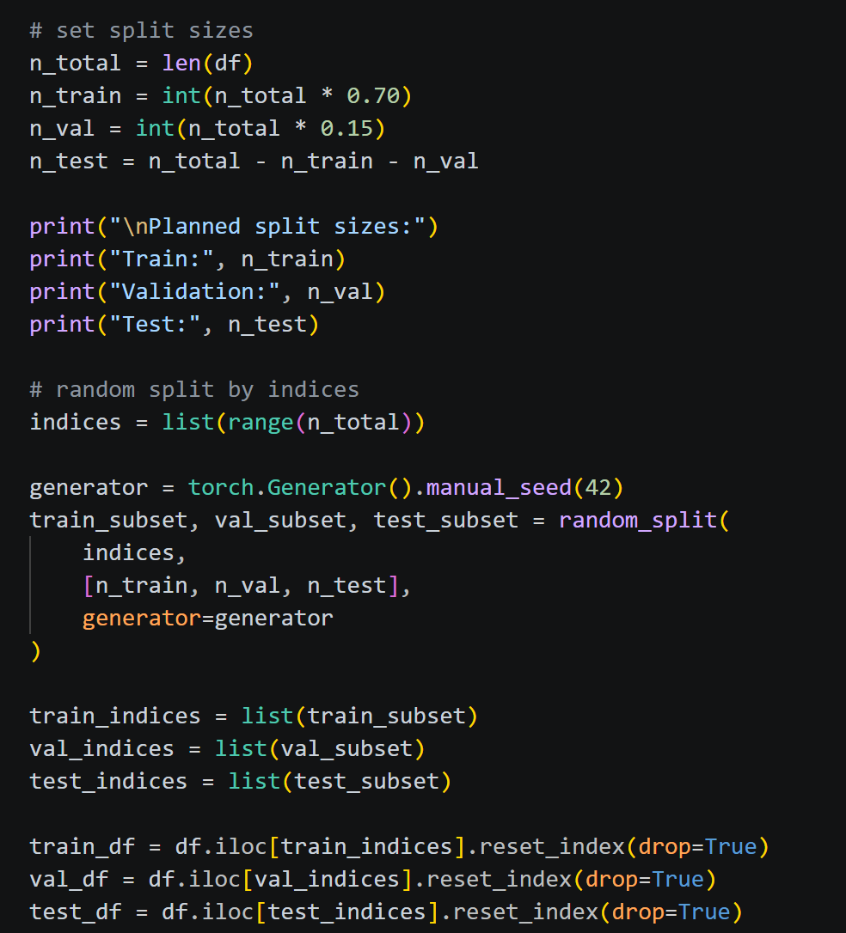
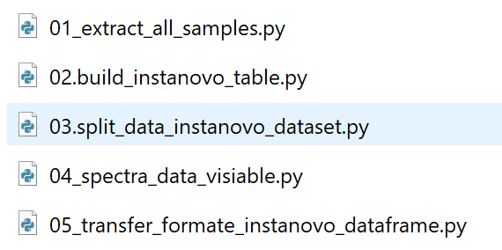
Step 2- Prepare dataset overview
1. Raw MS data
Data size: 20 raw files
Samples collected over three months
Two urban locations
2. Database search
Database coverage:
12 bacterial orders
35 representative species
144,457 protein sequences
3. Filter reliable data
Results:
4,123 peptide-spectrum matches
965 final high-confidence spectra
4. Build the training table
Link each peptide label with its MS/MS spectrum
Output: InstaNovo training table
5. Split and transfer format
Train / validation / test: 676 / 144 / 146 spectra
Output: parquet dataset for training

Slide 8
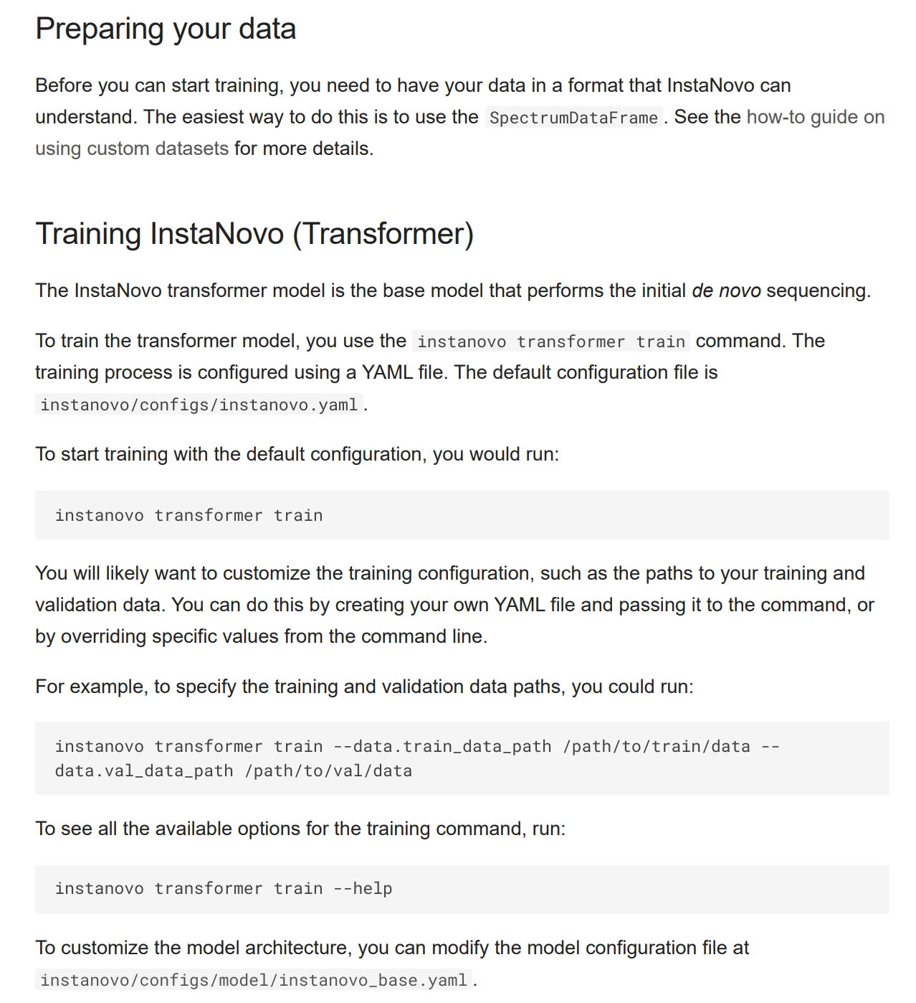
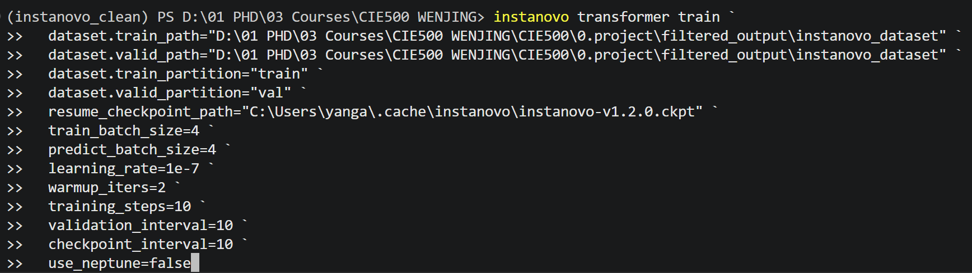
Step 3- Fine-Tuning of InstaNovo
1. Run InstaNovo fine-tuning
initialize from pretrained model
hyperparameter settings
Getting started with InstaNovo - InstaNovo

Slide 9
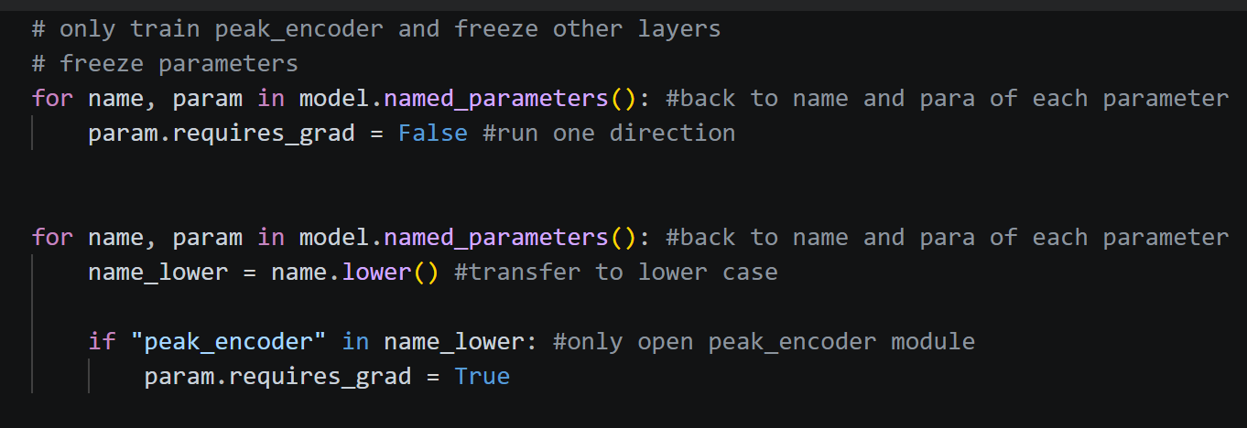
Step 3- Fine-Tuning of InstaNovo
2. Try to modify the model for better results:
Used conservative hyperparameters: learning rate, training steps, batch size
Used layer freezing: Froze all model parameters without peak_encoder only

Slide 10
Step 3- Evaluation
Model | Total spectra | |delta_mass_ppm| <= 20 (counts) | Amino acid precision | Peptide precision | Modification-containing predictions
Official InstaNovo | 146 | 116 | 64% | 41% | 21
Fine-tuned model | 146 | 1 | 0.4% | 0% | 145
*delta_mass_ppm = (predicted mass - observed precursor mass) / observed precursor mass × 1,000,000
target_sequence | official_prediction | official_delta_mass_ppm | finetuned_prediction | finetuned_delta_mass_ppm
AAQYVAAHPGEVCPAK | AAQYVAAHPPSTCPAK | 0.206188941 | TTTTTTTTT | 12374.13323
AAVEEGVVPGGGVALVR | AAVEEGVVPVLEVLR | 16.24331597 | TTTTTGTTT | 34618.34436
FLFNNGYADEVVR | LFFNNGYADLQNK | 0.09528558 | STTTTSSSSSST | 6111.032059
VALSGLSIAEYFR | VALSGLSLAEYFR | 0.956967187 | TTTTTTTS | 36181.73968
GVSLGSDAFFPFGDNIER | VGVTLCAFFGEDDAAVEK | 1.498649031 | TTTTTSTSSSSSST | 16367.91555
* Close to 0 is great
*Delete UNIMOD:21 behind each amino acid

Slide 11
3 Conclusion
The fine-tuned model completed training, but it failed to generalize the right prediction.
Compared with the official model, it produced much larger precursor mass errors and excessive modification-containing predictions.
Possible reasons for poor fine-tuning performance:
Very small fine-tuning dataset compared with model size
Updating only the peak_encoder may still change how the model represents spectra.
Wastewater proteomics data may be different from the data used to train the original InstaNovo model.
Over-prediction of modification tokens such as UNIMOD:21

Slide 12
Thank you & question

